Slide 1
Format

Slide 2
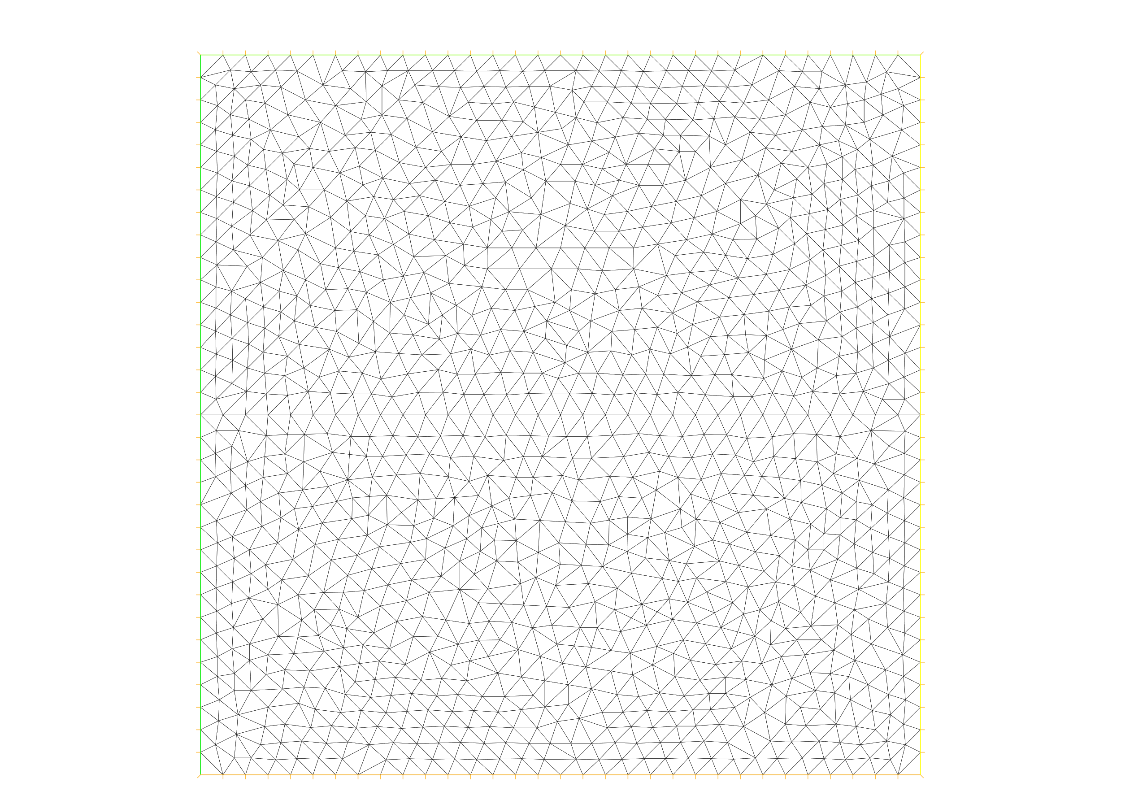
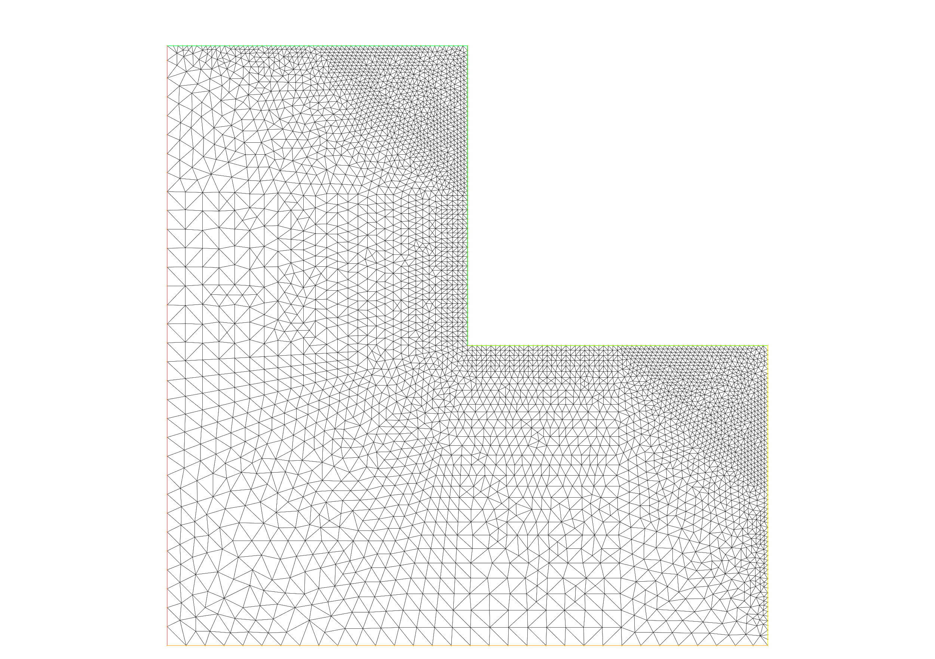
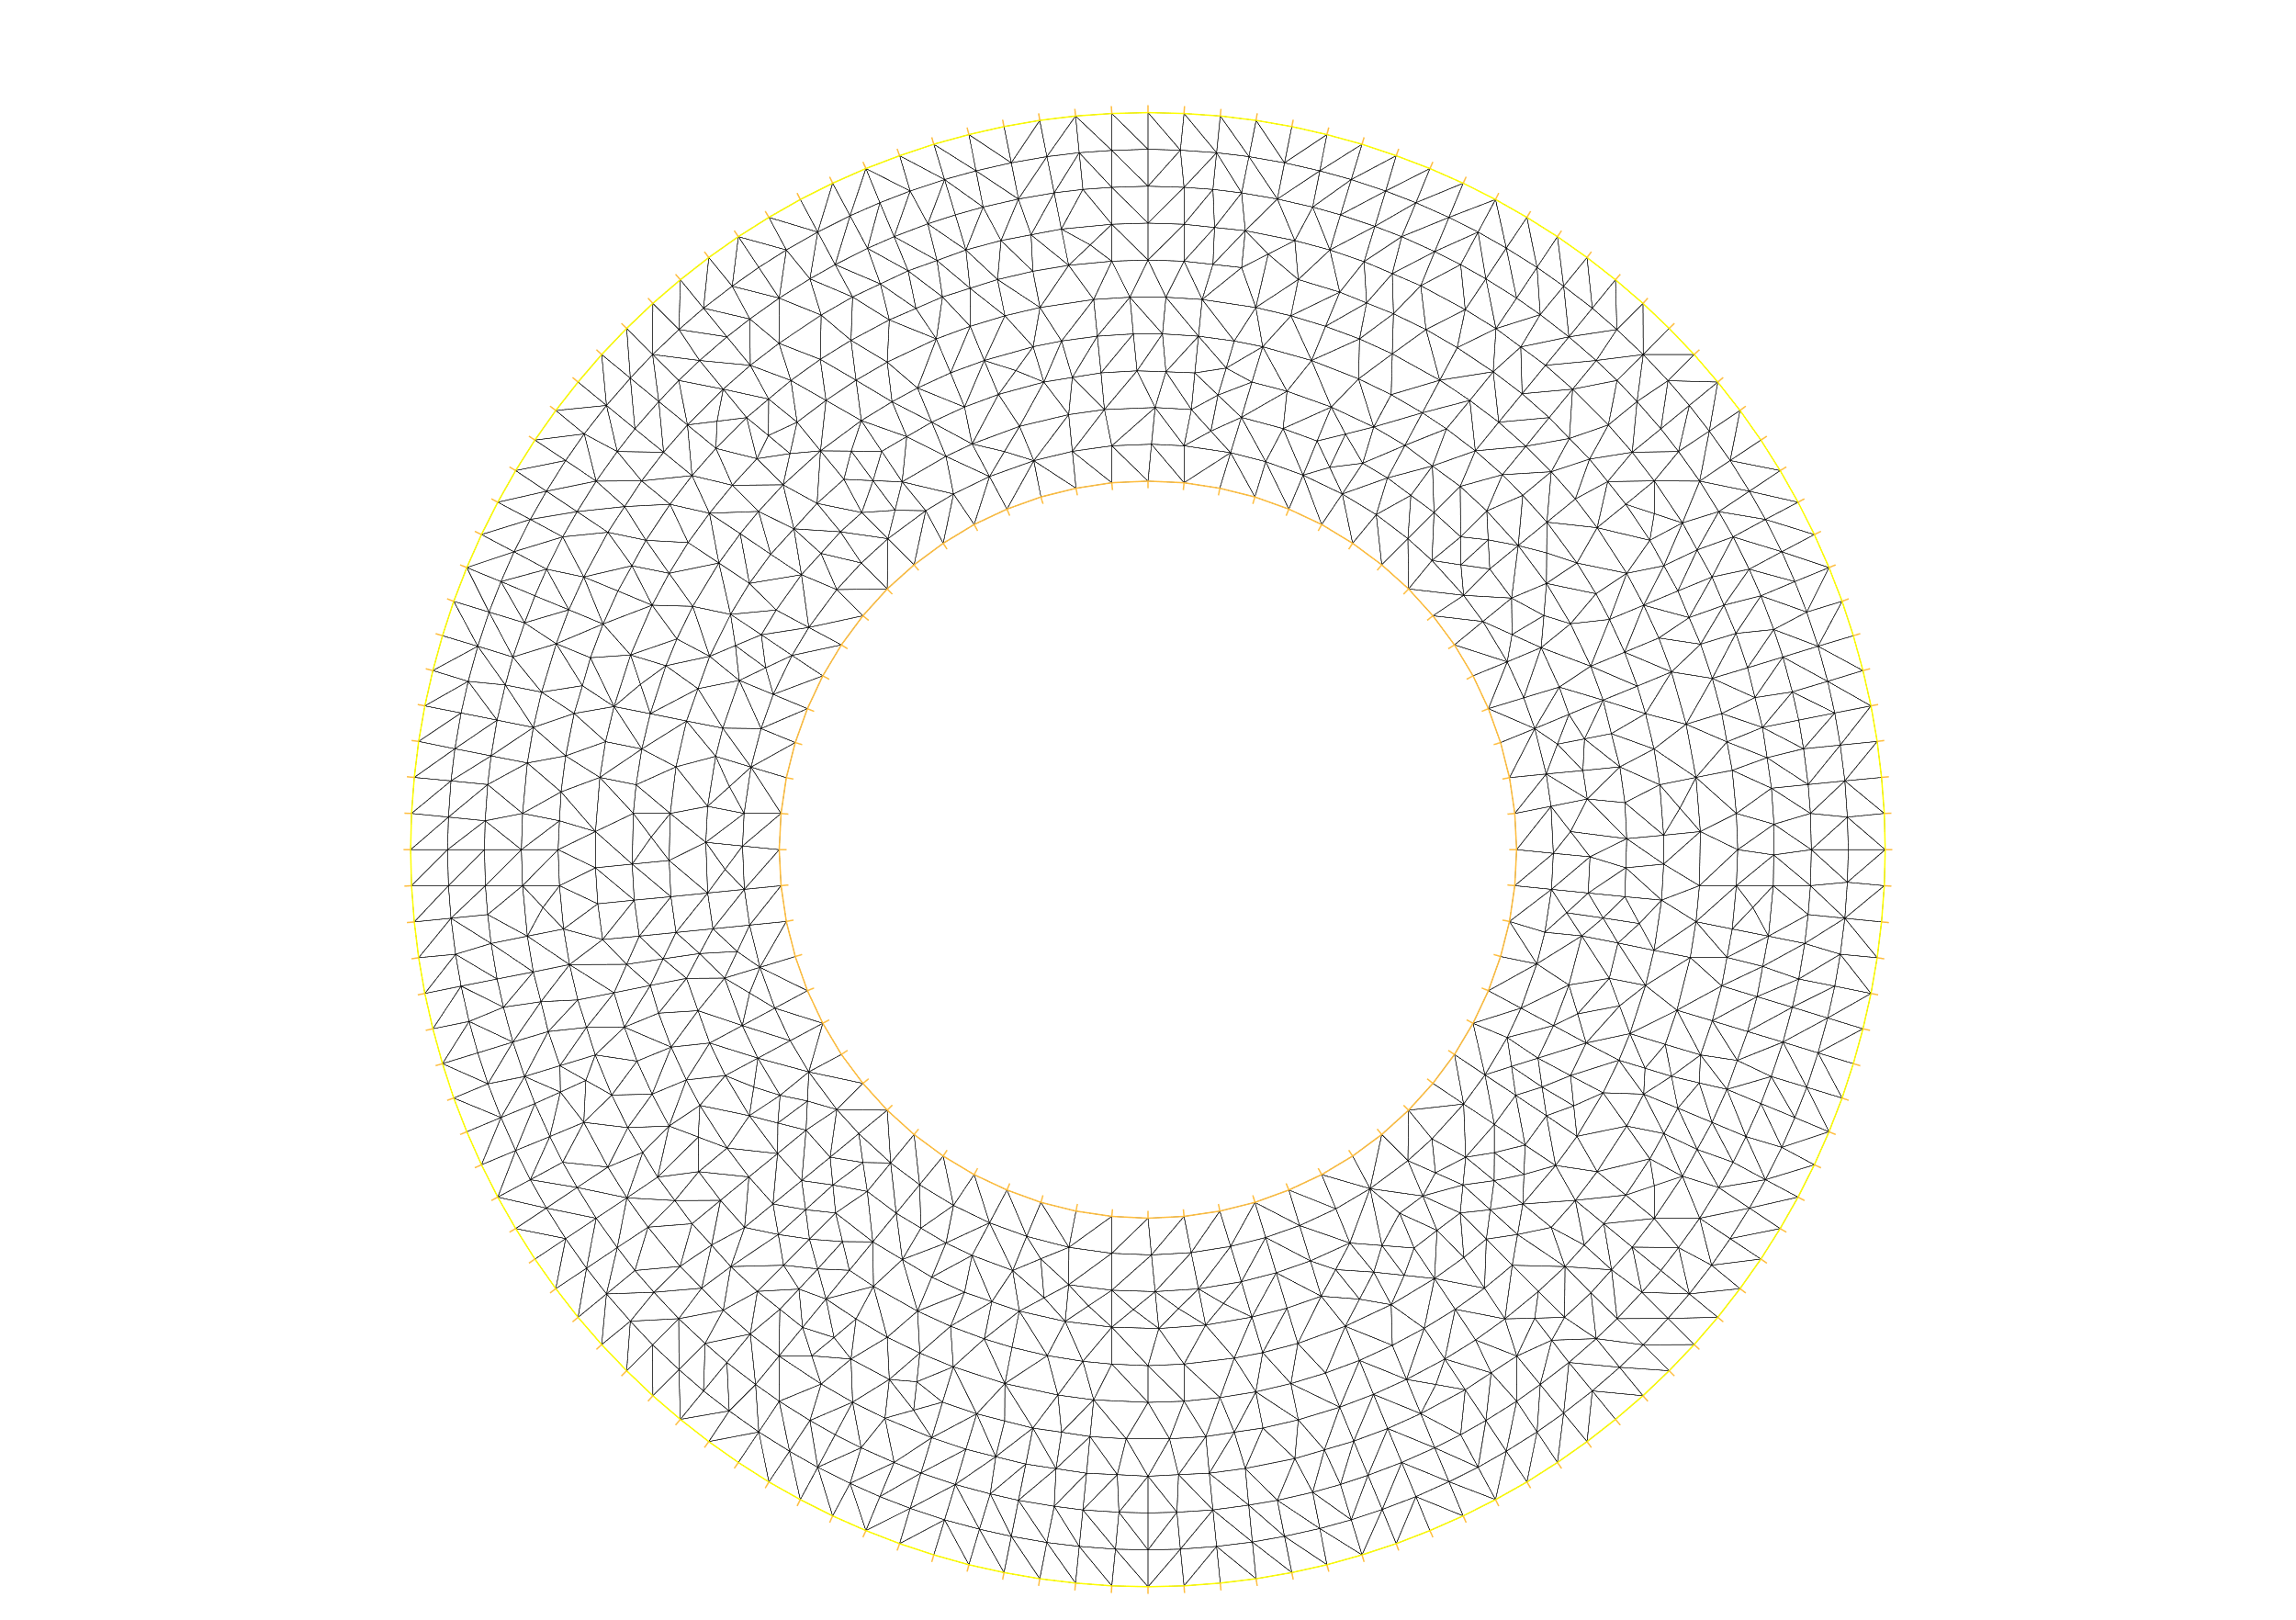
1
y
1
y
x
x
O
1
O
1
1
y
1
y
0.5
x
x
O
0.5
1
O
1
y
y
1
1
0.75
0.5
0.25
x
x
O
0.25
0.5
0.75
1
O
1

Slide 3
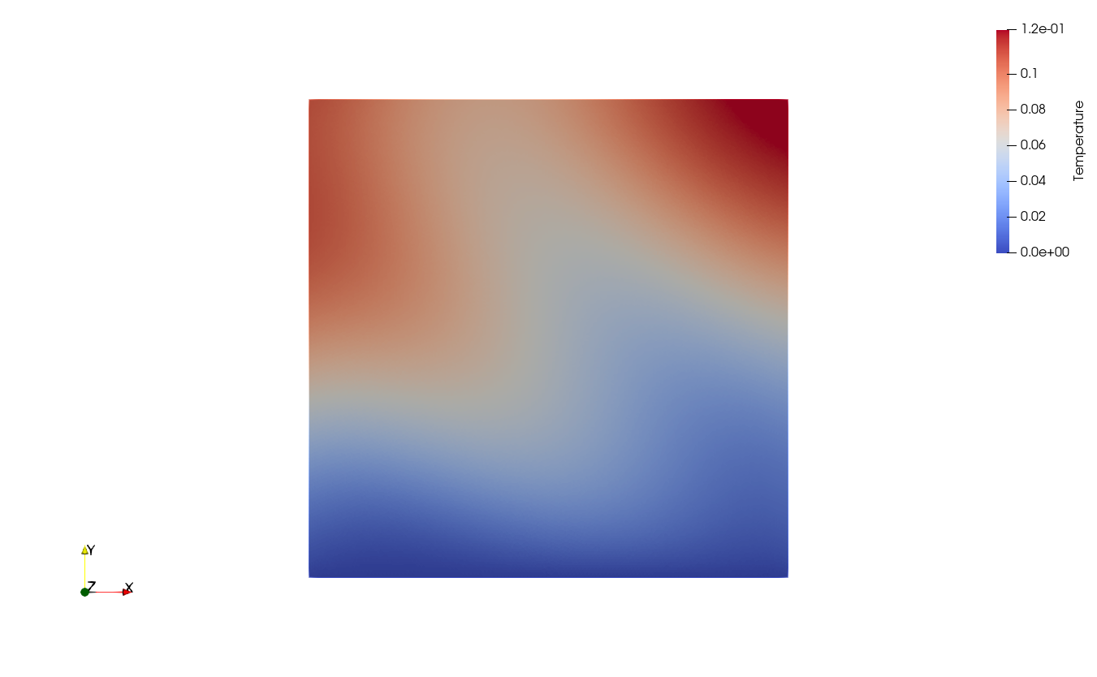
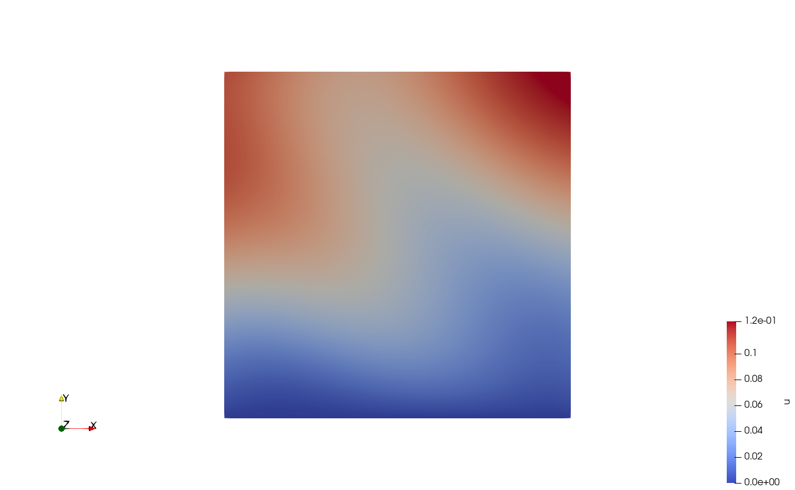
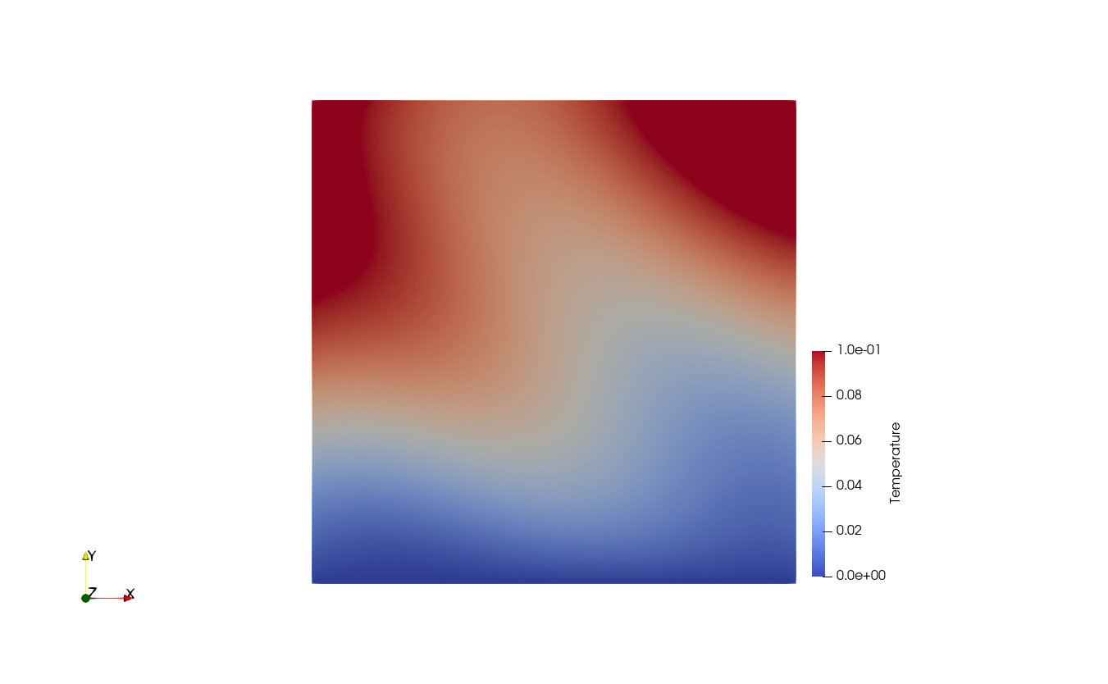
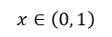
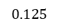
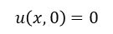
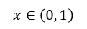
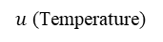
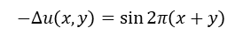
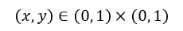
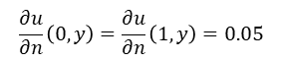
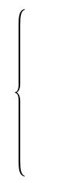
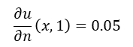
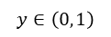
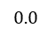
$$−Δu\left(x,y\right)=\sin{2π\left(x+y\right)}$$
$$\left(x,y\right)∈\left(0, 1\right)×\left(0, 1\right)$$
$$u\left(x,0\right)=0$$
$$x∈\left(0, 1\right)$$
$$\frac{∂u}{∂n}\left(x,1\right)=0.05$$
$$x∈\left(0, 1\right)$$
$$\frac{∂u}{∂n}\left(0,y\right)=\frac{∂u}{∂n}\left(1,y\right)=0.05$$
$$y∈\left(0, 1\right)$$
FreeFEM
numpy
y
1
y
1
y
1
x
x
O
1
O
1
x
O
1
$$0.0$$
$u$ (Temperature)
$$0.125$$

